Slide 1

IT5002
Computer Systems and Applications
Lecture 15
Memory Management
colintan@nus.edu.sg

Slide 2
Learning Objectives
By the end of this lecture you will be able to:
Understand the concept of address spaces and memory management.

Slide 3
Introduction
Memory is crucial for computers:
Used to store:
Kernel code and data
User code and data
What responsibilities does the OS have here?
Allocate memory to new processes.
Manage process memory.
Manage kernel memory for its own use.
Provide OS services to:
Get more memory, e.g. via malloc.
Free memory, e.g. via free
Protect memory.

Slide 4
PHYSICAL MEMORY ORGANIZATION

Slide 5
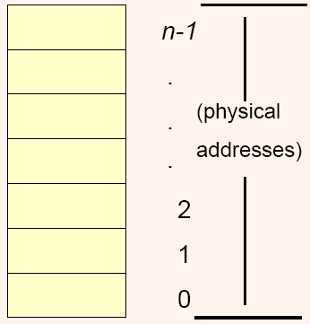
Physical Memory Organization
Physical memory is:
The actual matrix of capacitors (DRAM) or flip-flops (SRAM) that stores data and instructions.
Arranged as an array of bytes.
Memory addresses serve as byte indices.

Slide 6
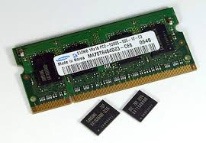
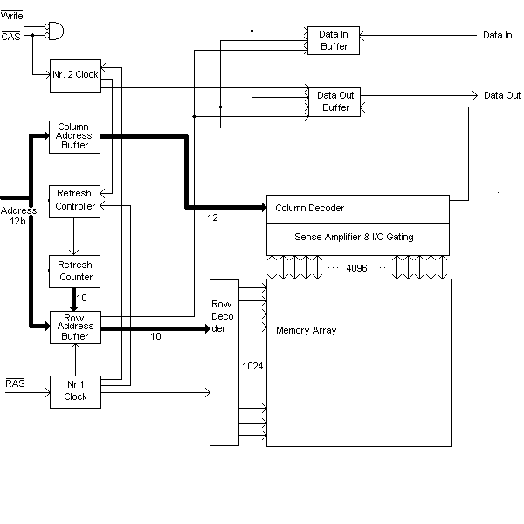
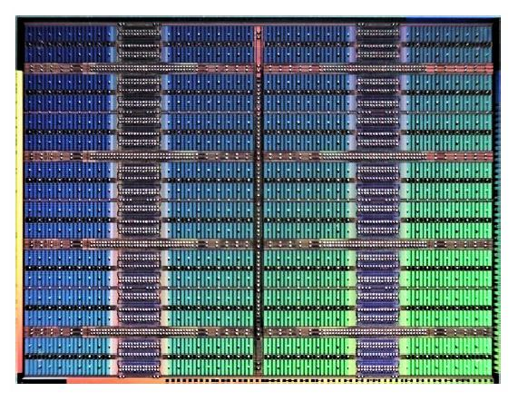
Physical Memory Organization

Slide 7
Words
Physical memory is organized in bytes, but CPUs often transfer data in units of >1 byte.
This unit is known as a “word”.
1 byte in 8-bit machines (ATMega328P, Intel 8080), 2 bytes in 16 bit machines (Intel 80286), 4 bytes in 32-bit machines (Intel Xeon), 8 bytes in 64-bit machines (Intel Celeron)
How do we map multi-byte words to single-byte memory?

Slide 8
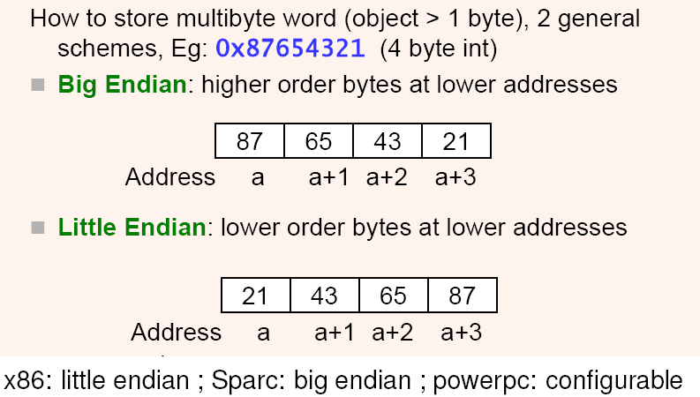
Endianness

Slide 9
Alignment Issues
Data can be fetched across word boundaries.
E.g. fetching from address 1 in a 32-bit machine:
Bytes from addresses 0 to 3 are fetched.
Bytes from addresses 4 to 7 are fetched.
Bytes from addresses 0, 5 to 7 are discarded.
Bytes from addresses 1 to 3, 4 are merged.
SLOW!!

Slide 10
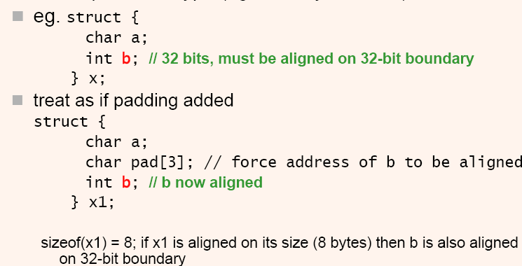
Alignment Issues
Since mis-aligned reads are very inefficient, data structures should always be created in units of words.
Add unused bytes to ensure this.

Slide 11

Alignment Issues
Due to CPU fetch circuitry design, instructions usually must be fetched on word boundaries.
Instructions fetched across word boundaries trigger “Bus Error” faults.
√
X

Slide 12
MEMORY MANAGEMENT

Slide 13
Memory Management
Why Memory Management?
We want to use memory efficiently:
What memory has already been allocated and to whom?
What memory is now free and usable by others?
We want to protect proceses from each other.
One process should not be able to trash another process or the OS.
E.g. we don’t want Process 1 to be messing about with the variables and memory used by Process 2.

Slide 14
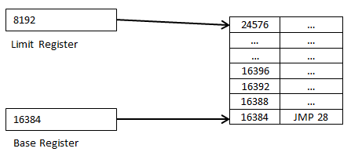
Logical vs. Physical Addresses
Logical addresses:
These are the addresses as “seen” by executing processes code.
Physical addresses:
These are addresses that are actually sent to memory to retrieve data or isntructions.

Slide 15
Multiple Program Systems
Having multiple processes complicates memory management:
Conflicting addresses.
What if >1 program expects to load at the same place in memory?
Access violations.
What if 1 program overwrites the code/data of another?
Worse, what if 1 program overwrites parts of the operating system?
The ideal situation would be to give each program a section of memory to work with.
Basically each program will have its own address space!

Slide 16
Multiple Program Systems: Base and Limit Registers
To do this we require extra hardware support:
Base register:
This contains the starting address for the program.
All program addresses are computed relative to this register.
Limit register:
This contains the length of the memory segment.
These registers solve both problems:
We can resolve address conflicts by setting different values in the base register.
If a program tries to access memory below the base register value or above the (base+limit) register value, a “segmentation fault” occurs!

Slide 17
Multiple Program Systems: Base and Limit Registers
All memory references in the program are relative to the Base Register.
E.g. “jmp 28” above will cause a jump to location 16412.
Any memory access to location 24576 and above (or 16383 and below) will cause segmentation faults.
Other programs will occupy spaces above and below the segment given to the program shown here.

Slide 18
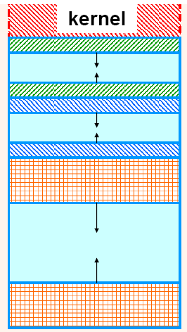
Multiple Program Systems: Partitioning
Base and limit registers allow us to partition memory for each running process.
Each process has its own fixed partition.
Assumed that we know how much memory each process needs.

Slide 19
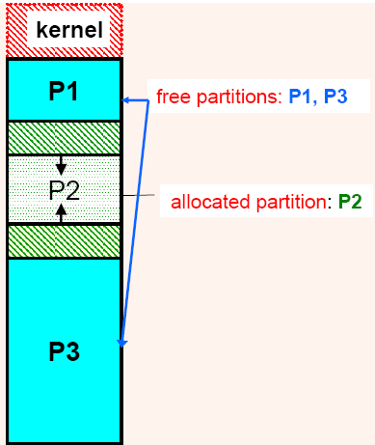
Partitioning Issues: Fragmentation
Two types of fragmentation can arise:
Internal fragmentation:
Partition is much larger than is needed.
Cannot be used by other processes.
Extra space is wasted.
External fragmentation:
Free memory is broken into small chunks by allocated memory.
Sufficient free memory in TOTAL, but individual chunks insufficient to fulfill requests.

Slide 20
Managing Memory within Processes
We’ve seen how we can manage multiple processes within an operating system. But:
What about memory within individual programs?
OS allocates memory for instructions.
Global variables are created as part of the program’s environment, and don’t need to be specially managed.
A “stack” is used to create local variables and store local addresses.
A “heap” is used to create dynamic variables.

Slide 21
Managing Memory within Processes
E.g. in UNIX, process space is divided into:
Text segments: Read-only, contains code. May have >1 text segments.
Initialized Data: Global data initialized from executable file. E.g. when you do:
char *mesg[]=“Hello world!”;
BSS Segment: Contains uninitialized globals.
Stack: Contains statically allocated local variables and arguments to functions, as well as return addresses.
Heap: Contains dynamically allocated memory.

Slide 22
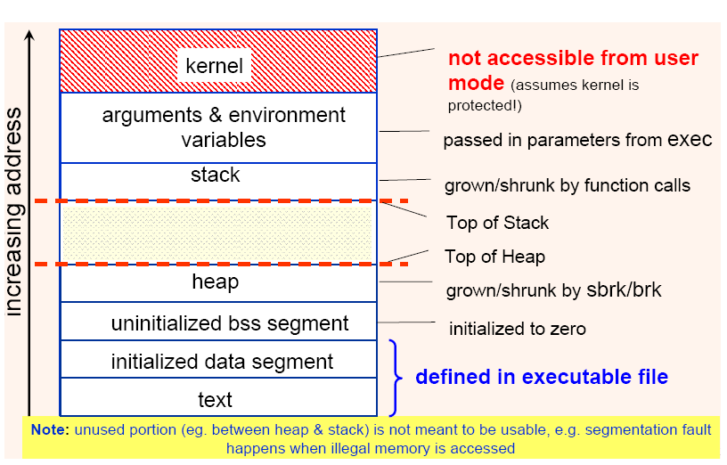
Managing Memory within Processes

Slide 23
Managing Free Memory
When memory can be allocated and de-allocated (e.g. using malloc/free or new/delete), it has to be managed by the operating system.
E.g. when a program requests for 168 bytes of memory, where should it come from?
When a program frees 215 bytes of memory, what should happen?
E.g. if it happens to be next to a 64 byte block of free memory, should they be coalesced into a single 279 byte block?
Should small fragments of free memory scattered all over be compacted?

Slide 24
Managing Free Memory
To manage free memory, we must know where these free chunks of memory are.
Two approaches:
Bit maps
Free/Allocated List
In either approach, memory is divided up into fixed sized chunks called “allocation units”.
Common sizes range from several bytes (e.g. 16 bytes) to several kilobytes.
Each “tick mark” in figure (a) on the next page represents the boundary of an allocation unit.

Slide 25
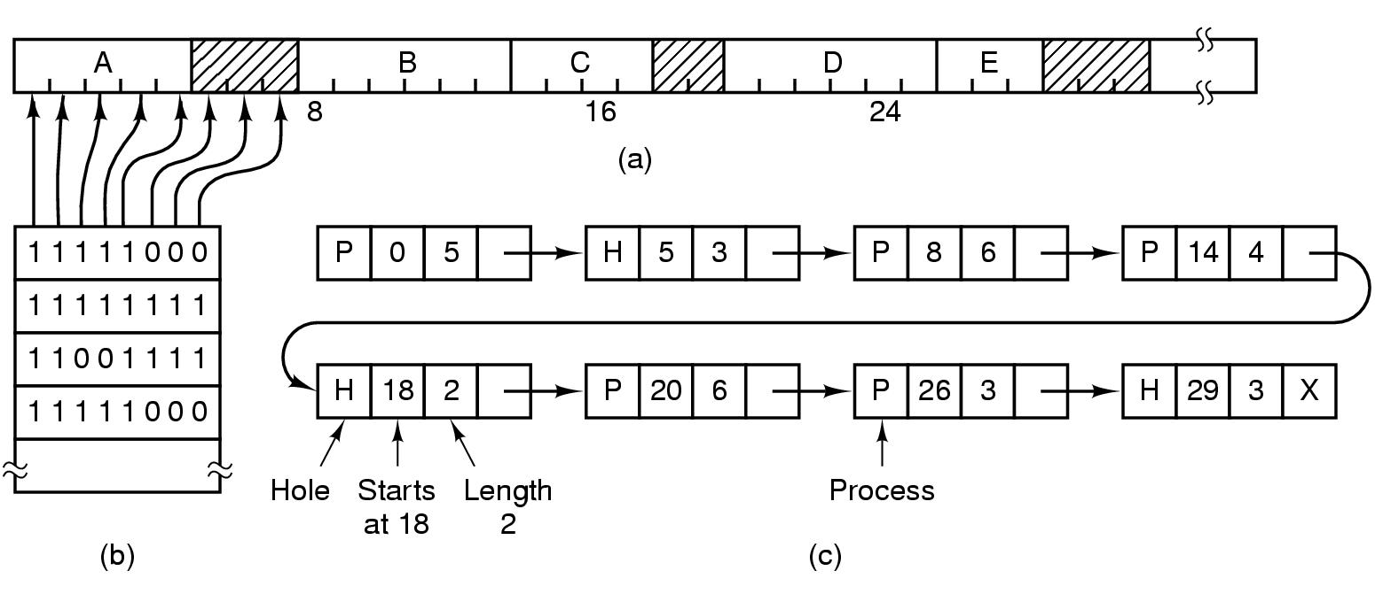
Managing Free Memory

Slide 26
Managing Free Memory Bit Maps
Figure (b) on the previous page shows how bit maps are used to keep track of free memory.
Each bit corresponds to an allocation unit.
A “0” indicates a free unit, a “1” indicates an allocated unit.
If a program requests for 128 bytes:
Find how many allocation units are needed. E.g. if each unit is 16 bytes, this corresponds to 8 units.
Scan through the list to find 8 consecutive 0’s.
Allocate the memory found, and change the 0’s to 1’s.
If a program frees 64 bytes:
Mark the bits corresponding to the 4 allocation units as “0”.

Slide 27
Managing Free Memory Free/Allocated List
Figure (c) shows an alternative method:
A single linked list is used to track allocated (“P”) units and free (“H”) units.
Each node on the linked list also maintains where the block of free units start, and how many consecutive free units are present in that block.
Allocating free memory becomes simple:
Scan the list until we reach a “H” node that points to a block of a sufficient number of free units.

Slide 28
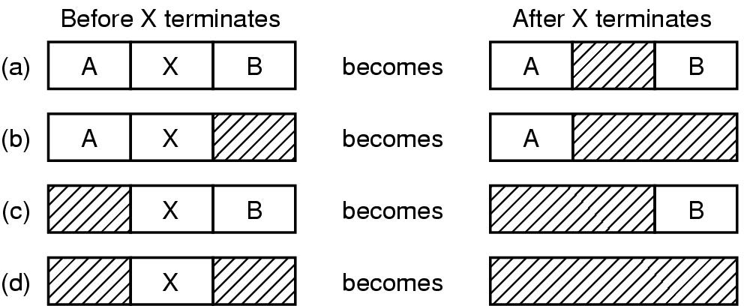
Managing Free Memory Free/Allocated List
The list is implemented as a double-linked list.
Diagram below shows possible “neighbor combinations” that can occur when a process X terminates.
The “back pointer” in a double-linked list makes it easy to coalesce freed blocks together.

Slide 29
Managing Free Memory Allocation Policies
The bit map and linked list tell us where the free space is, but not what to allocate!
There are several possibilities on how to do this.
Note that in each case, whatever free allocation units left at the end of an allocated block is returned to the free list.
E.g. if a block of 8 units is found and only 6 are needed, the remaining 2 units are marked as “free”.
First Fit
Scan through the list/bit map and find the first block of free units that can fit the requested size.
Fast, easy to implement.

Slide 30
Managing Free Memory Allocation Policies
Best Fit
Scan through the list/bit map to find the smallest block of free units that can fit the requested size.
Theoretically should minimize “waste”.
However can lead to scattered bits of tiny useless holes.
Worst Fit
Find the largest block of free memory.
Theoretically should reduce the number of tiny useless holes.
We can sort the free memory from smallest to largest for best fit, or largest to smallest for worst fit.
This minimizes search time.
However coalescing free neighbors will be much harder.

Slide 31
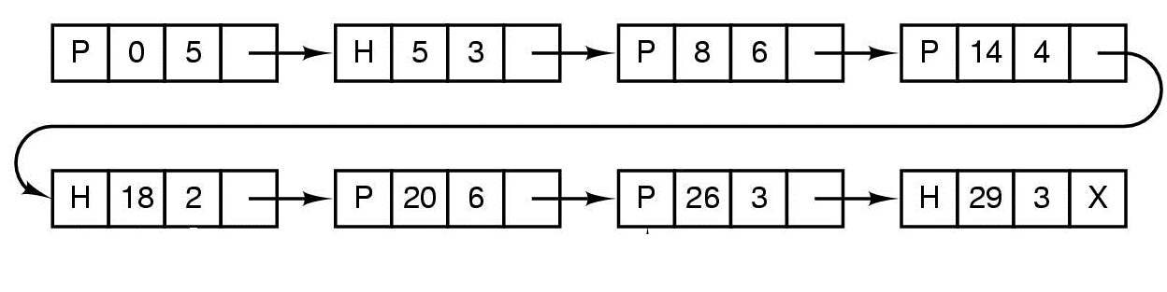
Managing Free Memory Allocation Policies
E.g. using first-fit and linked lists:
First allocation: 3 units.
Second allocation: Another 3 units.
First Allocation

Slide 32

Managing Free Memory Allocation Policies
Second Allocation

Slide 33
Buddy Allocation (aka Quick Fit)
This is an efficient (better than O(n)) way to manage free blocks.
Binary splitting.
Half of the block is allocated.
The two halves are called “buddy blocks”.
Can coalesce again when two buddy blocks are free.
This scheme is also known as Quick Fit.

Slide 34
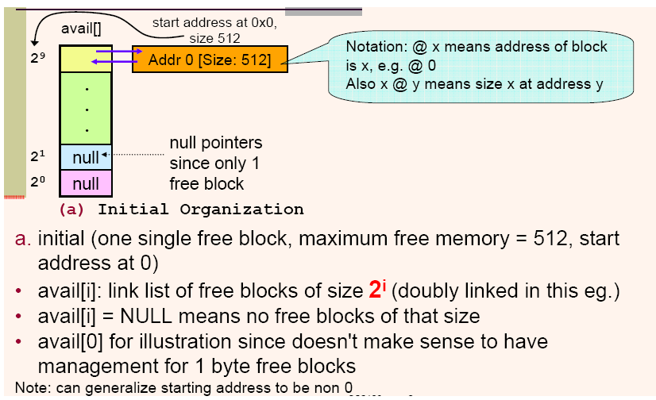
Buddy Allocation

Slide 35
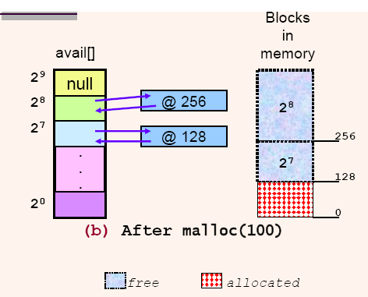
Buddy Allocation
Example:
We initially have one free block of 512 bytes.
We want to do malloc(100)
Steps:
Split 512 byte block into 2 blocks of 256 bytes.
Split one 256 byte block into two 128 byte blocks.

Slide 36
Buddy Allocation
These allocations have created blocks at addresses:
0 to 127: the block given to the malloc, since we return the first free block of at least 100 bytes.
128-255: The free buddy block of the block at address 0.
256-511: The free buddy block of the block that was broken up to 0-127 and 128-255.
Suppose now we want to do malloc(256).
Block at address 256 is returned.

Slide 37
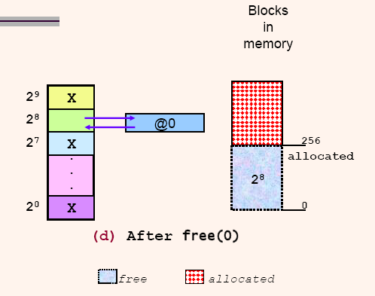
Buddy Allocation
We now call free(0):
This frees up addresses 0 to 127.
Coalesces with its buddy block to form a single 256 byte block at address 0.

